Slide 1
10/19/2022
Today’s lecture is intended to help you achieve the following learning objective: Explain the concept of regions related to a QM/MM calculation. Compare and contrast QM/MM with molecular mechanics.
Quantum Mechanics in Chemistry
What are the differences between molecular mechanics and quantum mechanics?
The Schrodinger Equation
Basis Sets
Overview of QM methods
Quantum Mechanics/Molecular Mechanics calculations
The 2013 Nobel Prize in Chemistry
How do hybrid calculations overcome the limitations of QM and MM?
The QM/MM Hamiltonian
Factors in selecting the QM region

Slide 2
Quantum Mechanics in Chemistry: An Overview
Learn more in Chem 454/550, offered Spring 2023!

Slide 3

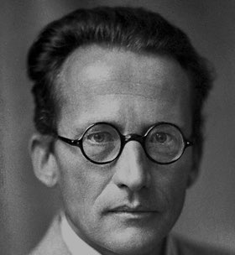
Molecular mechanics vs Quantum mechanics
inputs
coordinates
force field functions
force field parameters, including partial charge
outputs
energy
electron density (from coordinates and partial charge)
fast approximation to QM
energy is differentiable
inputs
coordinates
net charge
total spin
basis set
outputs
energy
wave function, which yields electron density and other properties
highly accurate in gas phase
philosophically confusing

Slide 4
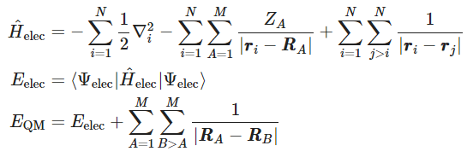
The Schrödinger Equation
The time-independent Schrödinger equation is $\overset{̂}{H}Ψ=EΨ$
$\overset{̂}{H}$ is the Hamiltonian operator
$Ψ$ is the wavefunction, where$|Ψ|^{2}$ is the electron density
$E$ is the energy
Born-Oppenheimer Approximation
mass of the nucleus >> mass of electron
velocity of electrons is much faster
electronic properties can be determined for fixed nuclei
Based on BO approximation, the electronic Hamiltonian is
Includes kinetic energy, electron-nuclear attraction, and electron-electron repulsion

Slide 5
Solvation
As in MM, continuum solvation methods used to model solvent in QM
Polarizable continuum model (PCM)
COnductor-like Screening MOdel (COSMO) - solvent is treated as a set of apparent charges on the surface of the solute cavity. These charges interact with the system according to Coulomb's law,
COSMO surface of a pentaacrylate molecule (red = negative, green = positive equilibrium layer).
By Matthias Gloede - Own work, CC BY-SA 3.0,
https://commons.wikimedia.org/w/index.php?curid=1370600
Charge density surface of 4-nitro-benzoicacid
By Andreas Klamt - Own work, CC BY-SA 3.0,
https://commons.wikimedia.org/w/index.php?curid=5810648

Slide 6
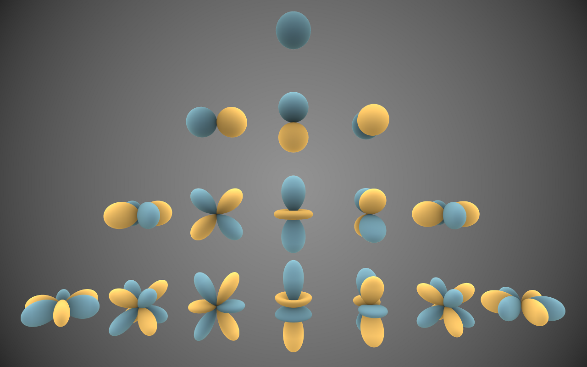
Basis sets
Generically, a collection of functions that are combined into a more complex function
For QM, a set of one-particle functions used to build molecular orbitals
Variation theorem - no approximate wave function can have lower energy than the exact ground state energy of the system
Larger basis set enables greater accuracy but higher cost of parameter optimization
Spherical harmonics, which describe atomic orbitals
By Inigo.quilez - Own work, CC BY-SA 3.0, https://commons.wikimedia.org/w/index.php?curid=32782753
Linear combinations of functions are more complex functions
A d-polarization function added to a p orbital. (CC-BY-SA-3.0; Rifleman 82)

Slide 7
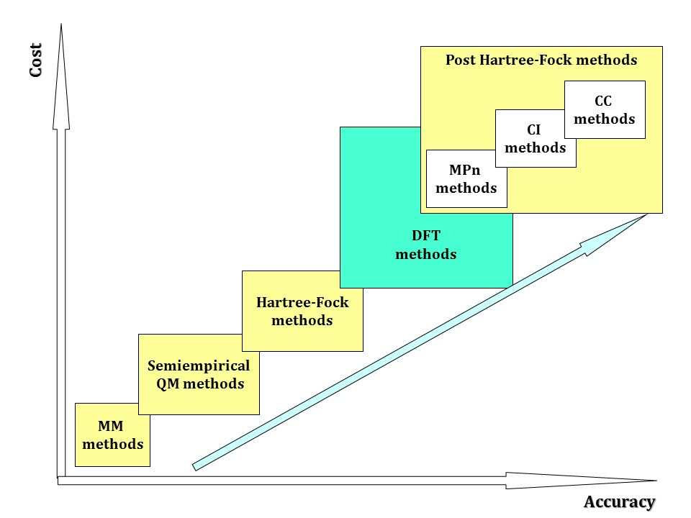
Accuracy and Cost of Methods
Semiempirical - some basis function parameters fixed
Hartree-Fock - electrons experience mean field of other electrons
DFT, Density Functional Theory - currently most popular, based on electron density opposed to wave function
MPn, Møller–Plesset perturbation theory - approximation method
CI, Configuration Interaction
CC, Coupled Cluster - maximizes accuracy with full electron correlations
The quest for a universal density functional: The accuracy of density functionals across a broad spectrum of databases in chemistry/ slideshare

Slide 8

Let’s Check!
Property | MM | QM
Separate models of nuclei and electrons |  | X
Energy depends on nuclei not electron positions | X
Faster | X
Electrons may be delocalized |  | X
Explicit electron – electron interactions |  | X
Differentiable energy function facilitates optimization and molecular mechanics | X
More complex function guarantees more accuracy |  | X

Slide 9
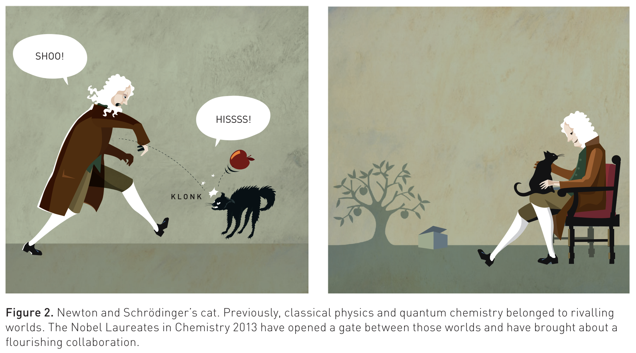
Quantum Mechanics / Molecular Mechanics
https://www.nobelprize.org/uploads/2018/06/popular-chemistryprize2013.pdf

Slide 10
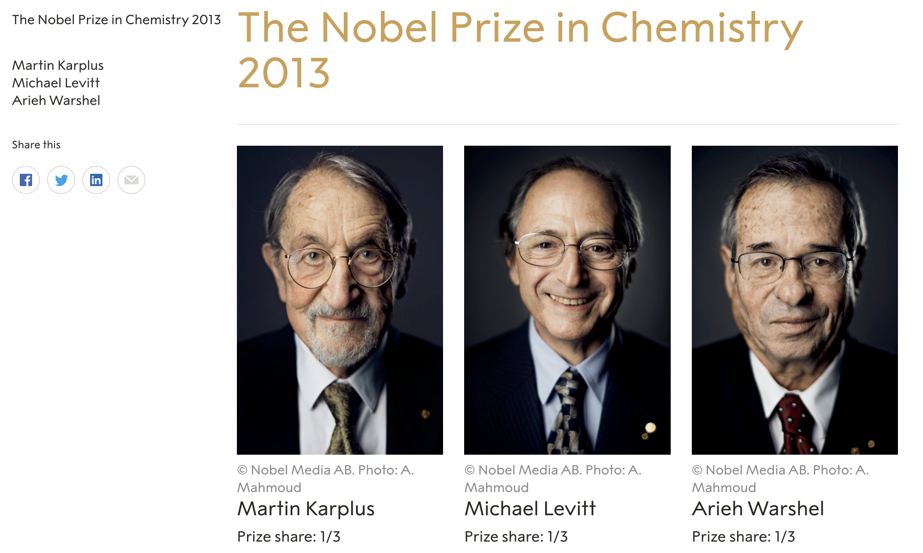
https://www.nobelprize.org/prizes/chemistry/2013/summary/

Slide 11
Overcoming Limitations
QM is accurate but too slow for more than a few hundred atoms, even with modern supercomputers
MM does not model
chemical reactions
electronic processes such as charge transfer / electronic excitation
The QM/MM compromise
QM within a chemically active region
MM for the surroundings
QM:
inner
region
MM: outer region

Slide 12
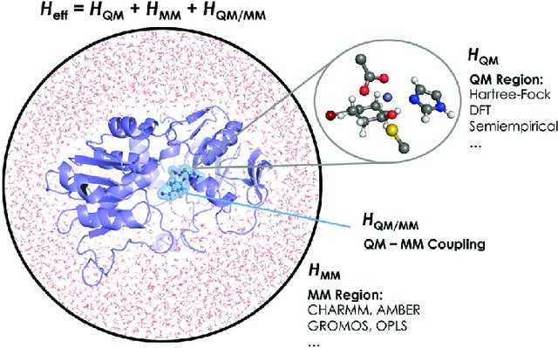
The QM/MM Hamiltonian
QM region
MM region
Coupling
bonded and vdW (Lennard-Jones)
electrostatic between point charges in MM region and
point charges assigned to atoms in the QM region or
expectation value of electrostatic potential energy
Chemical Communications, 53(2), pp.284-297.

Slide 13

The difference in the electronic probability density is plotted. Blue and red contours illustrate the gain and loss of the electronic probability density due to the embedding field.
Polarization energy compared to binding energy for 286 complexes

Slide 14
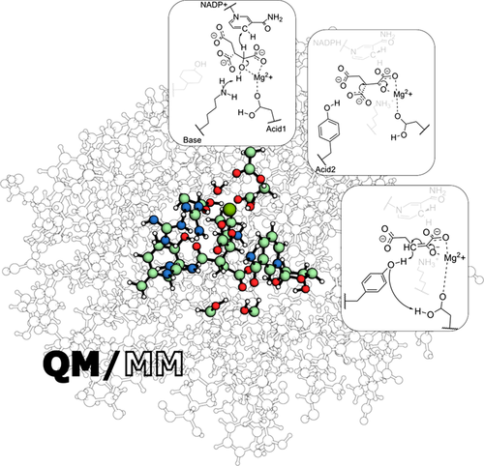
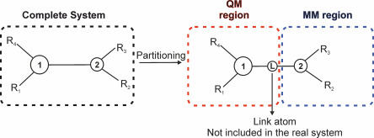
The Boundary
The boundary between QM and MM regions should be
far away from the reactive center
not involve bond formation and bond breaking
Bonds across regions can be capped (CA-CB -> CB-H), but complete molecules preferable
Sousa, S., Ribeiro, A., Neves, R., Brás, N., Cerqueira, N., Fernandes, P. and Ramos, M., 2016. Application of quantum mechanics/molecular mechanics methods in the study of enzymatic reaction mechanisms. WIREs Computational Molecular Science, 7(2).
Navizet, I., 2020. QM/MM Study of Bioluminescent Systems. Challenges and Advances in Computational Chemistry and Physics, pp.227-270.

Slide 15
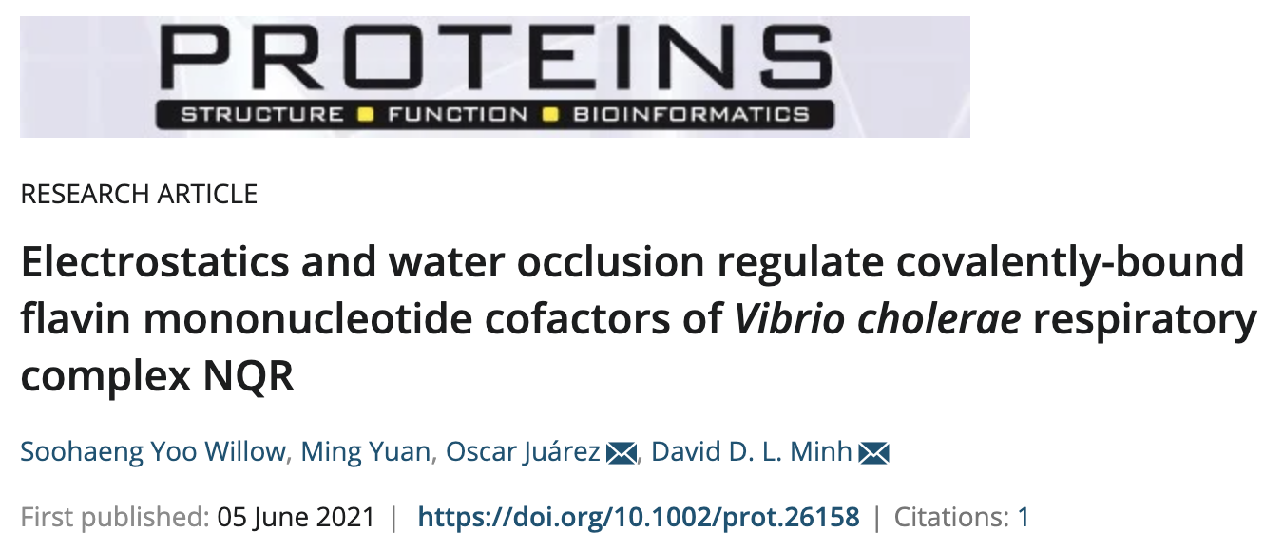
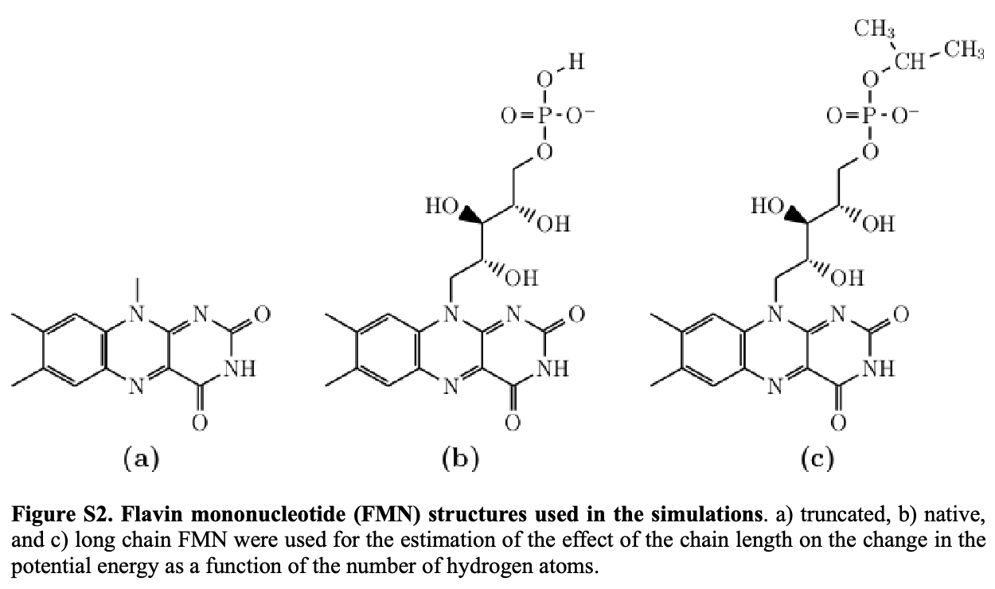
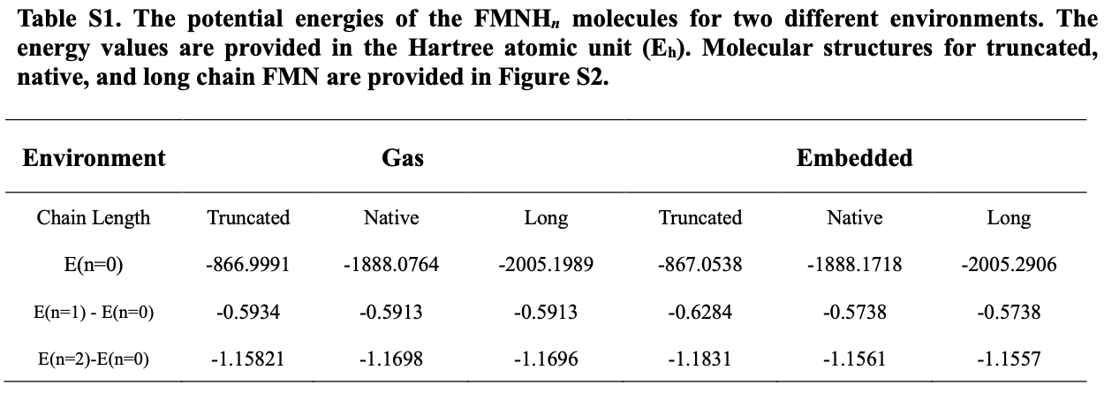
Is the covalent
bond important?
Is the chain
important?
Implicit solvent
FMNB
FMNC

Slide 16
Review questions
What is the difference between a QM calculation in gas versus in a region within a protein?
Describe a way to handle a covalent bond between the QM and MM region of a QM/MM calculation.
In a QM/MM calculation, how can we tell whether the QM region is large enough?

